Slide 1
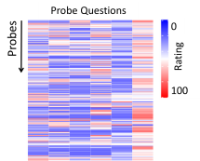
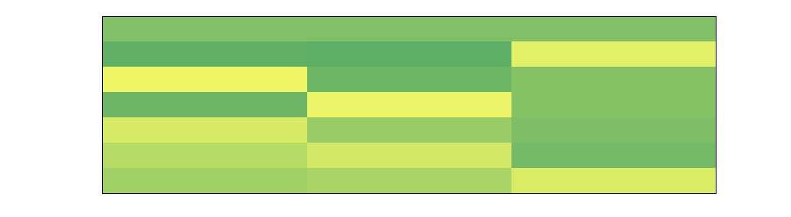
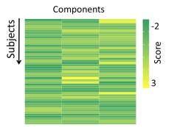

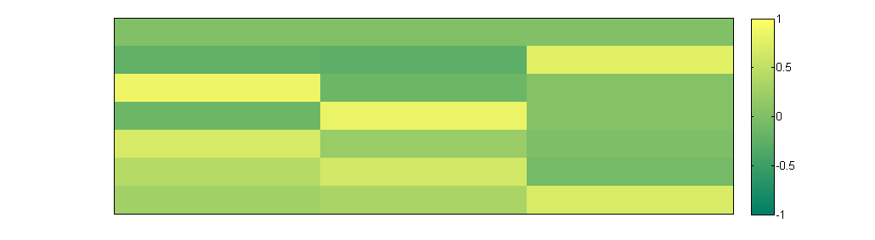
Experience Sampling
Laboratory Task
Probe level data
Dimensions
Group level
Questions
Components
Components
0
High
Trials
Questions
Subjects
100
Low
Notes:
Pipeline PCA

Slide 2
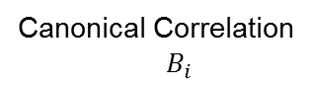
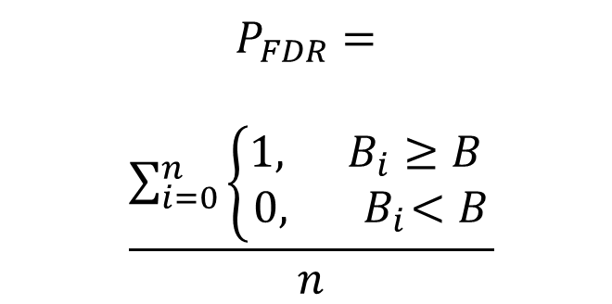
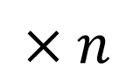
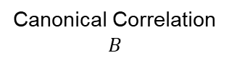
Sparse Parameter search
Resampling: 5-Fold
Sparsity Grid
Save the best result
Train Test
1 | 2 | 3 | 4 | 5
1st Canonical Correlation
Cognitive Tasks
Less
Cognitive Tasks
Less
1 | 2 | 3 | 4 | 5
1st Canonical Correlation
...
More
1st Canonical Correlation
More
1 | 2 | 3 | 4 | 5
Less
More
Less
More
Functional Connectivity
Functional Connectivity
Permutation Test
Permuted
Cognitive Tasks
Connectivity
Cognitive Tasks
Connectivity
$$P_{FDR}=$$
$$\frac{\sum_{i=0}^{n}{\left\{\begin{aligned}1, B_{i}≥B \\ 0,{ B}_{i}<B\end{aligned}\right.}}{n}$$
$$×n$$
Canonical Correlation
$$B$$
Canonical Correlation
$${ B}_{i}$$
Notes:
Pipeline CCA

Slide 3
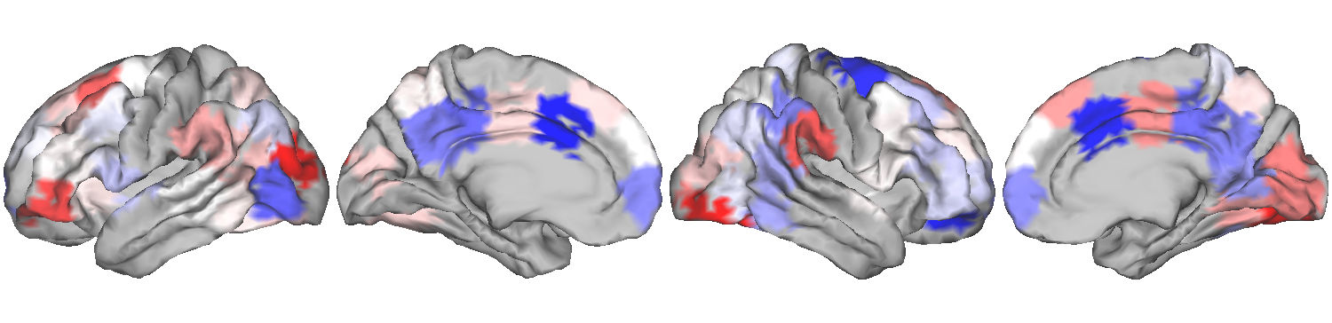
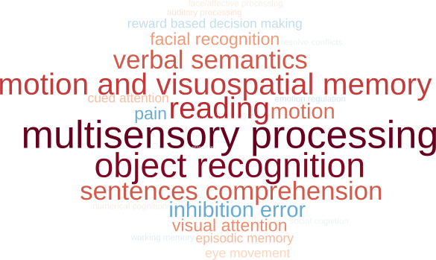
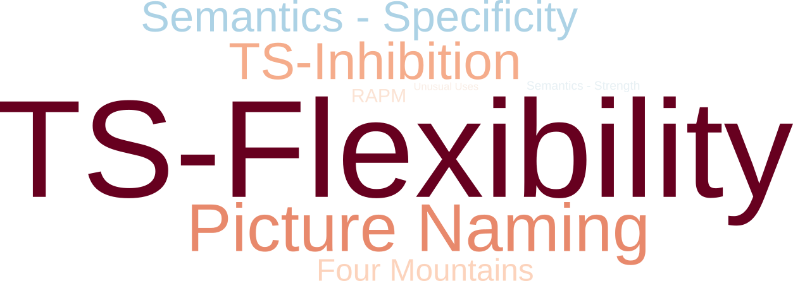
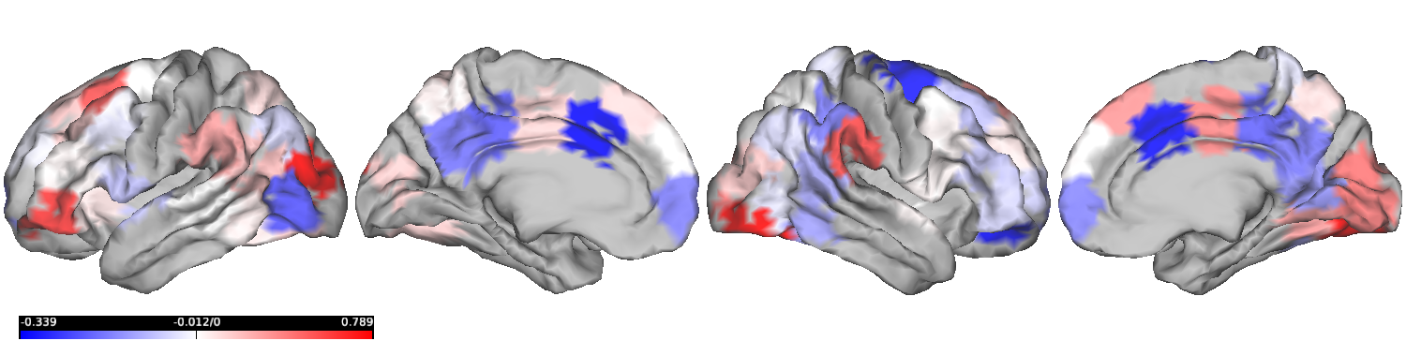
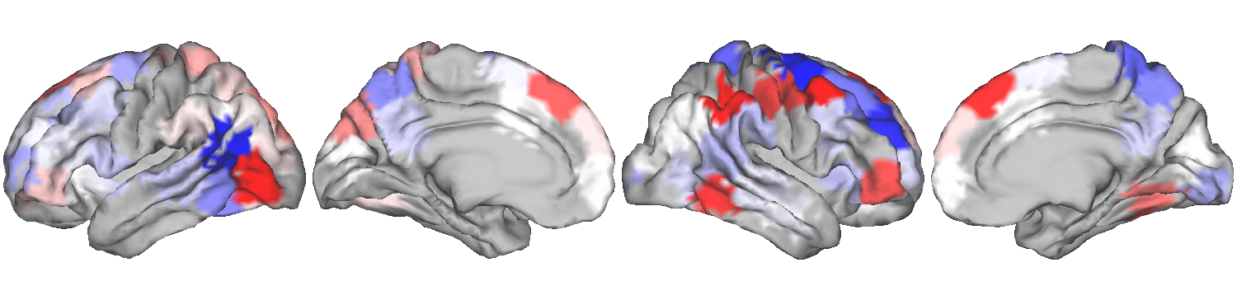
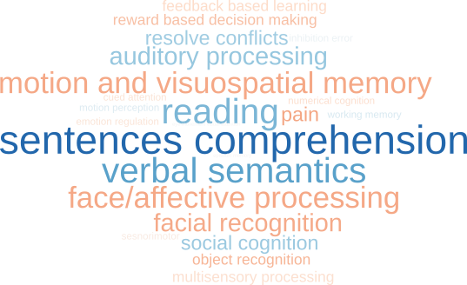

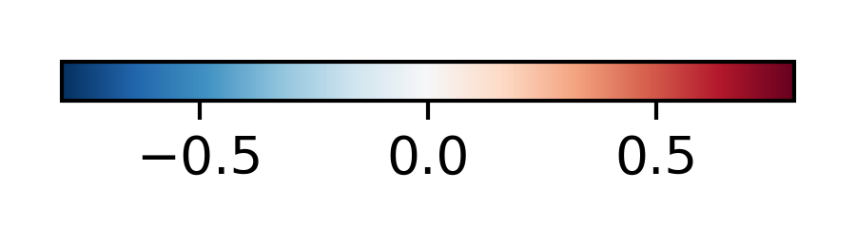
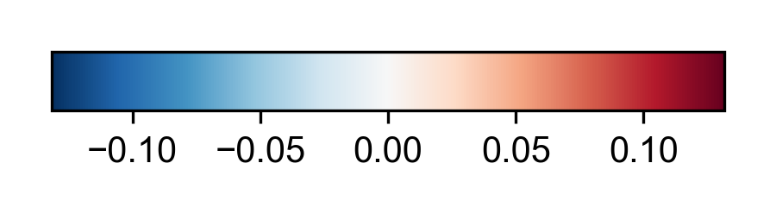
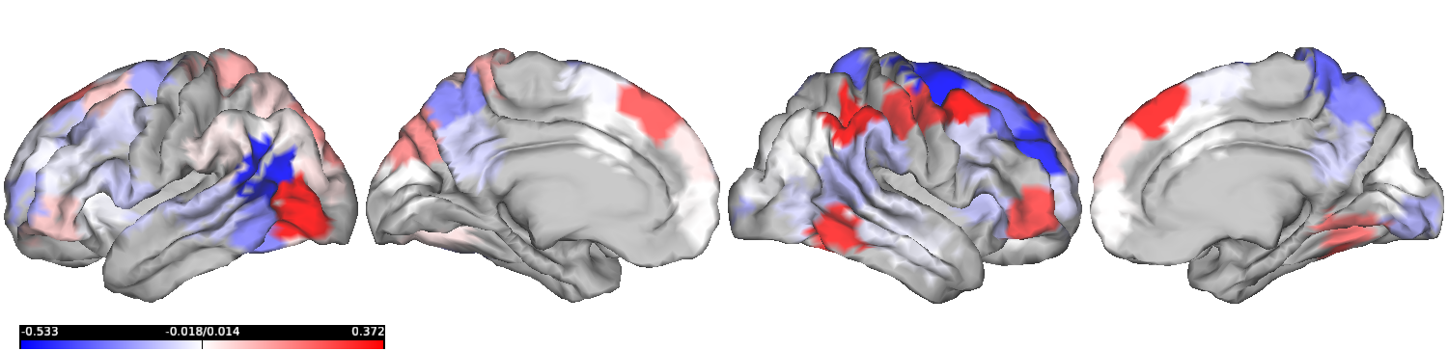
Task profile
Functional Connectivity (FC)
Neurosynth decoding

Slide 4
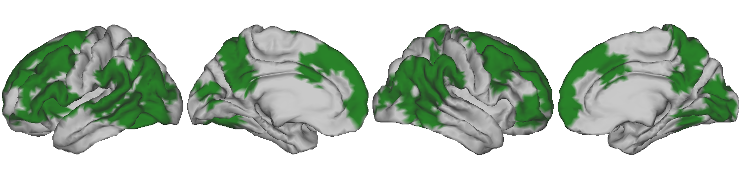
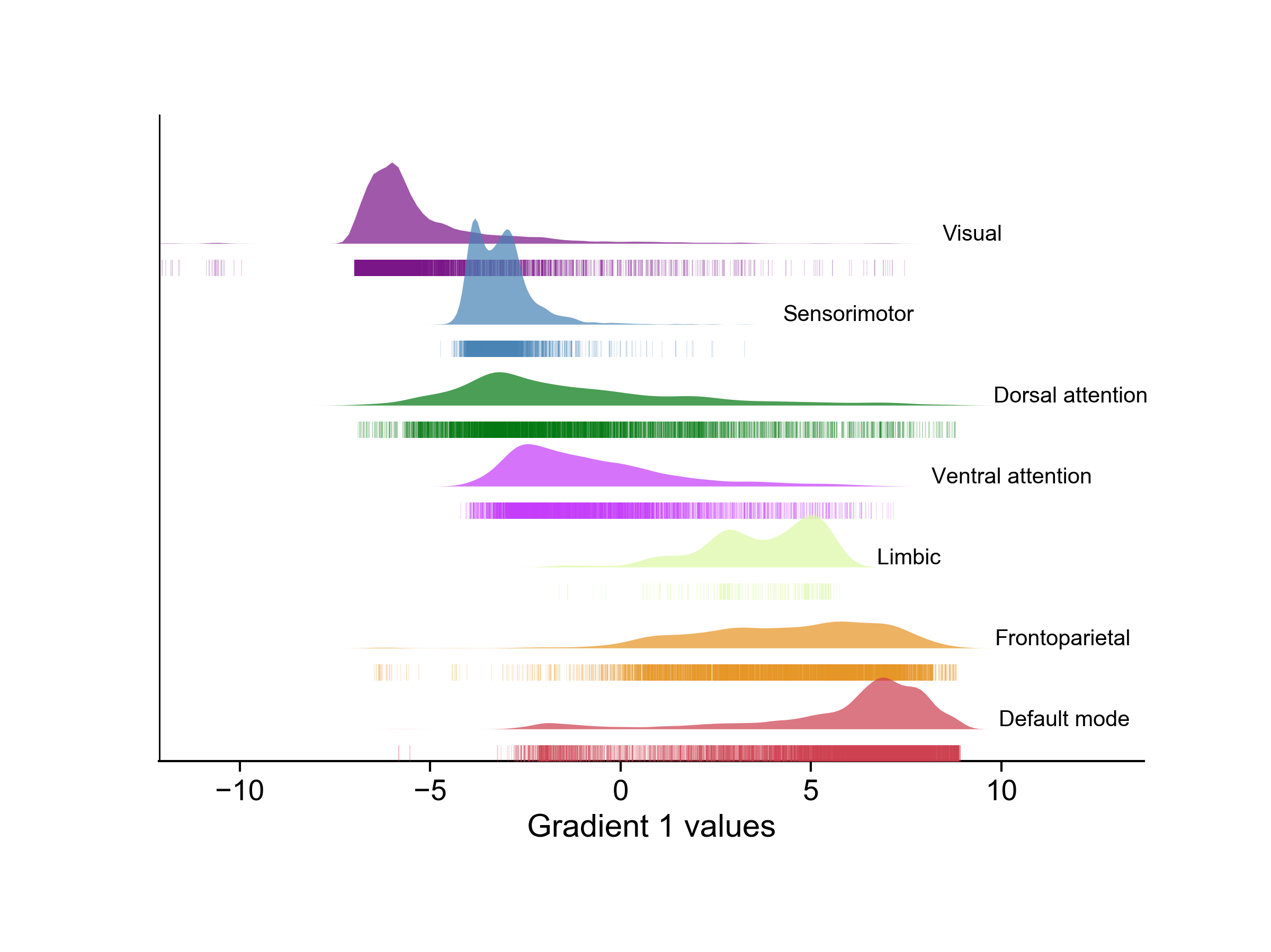
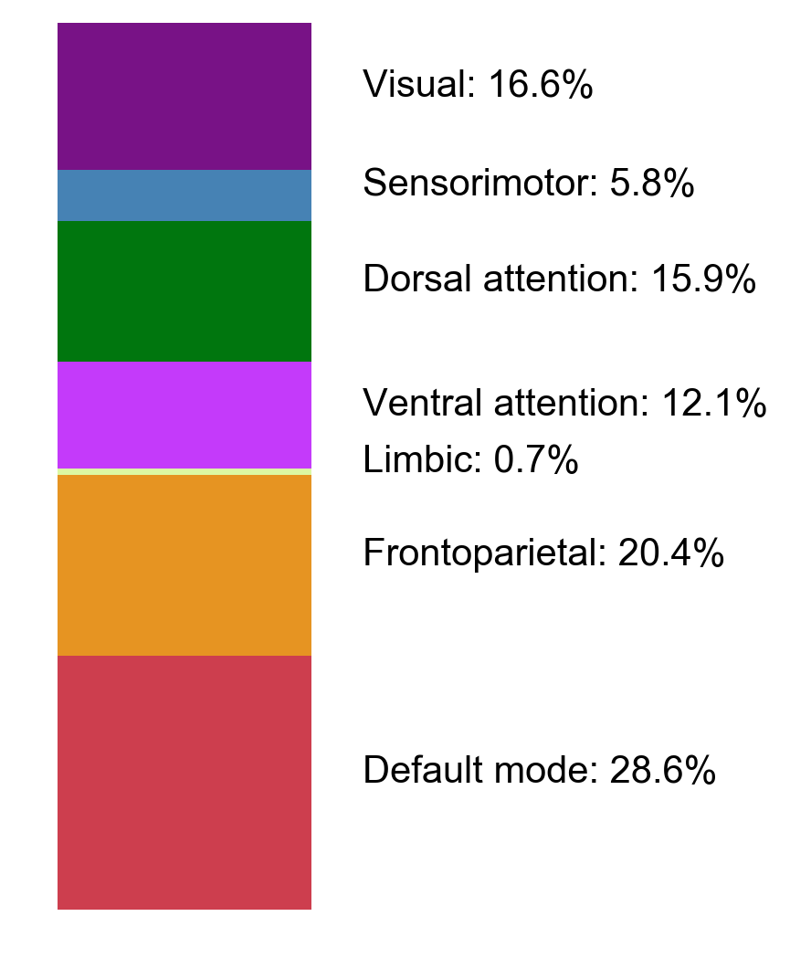
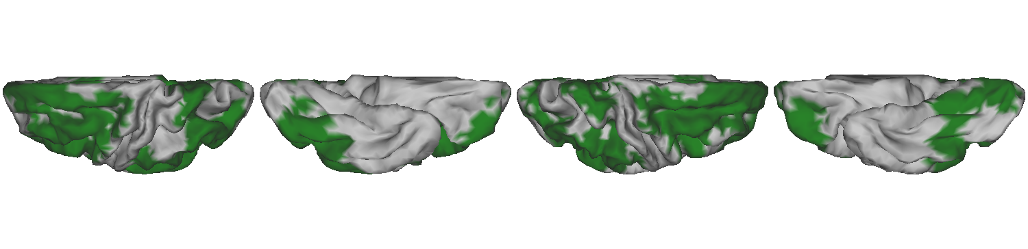
Regions common to both modes

Slide 5
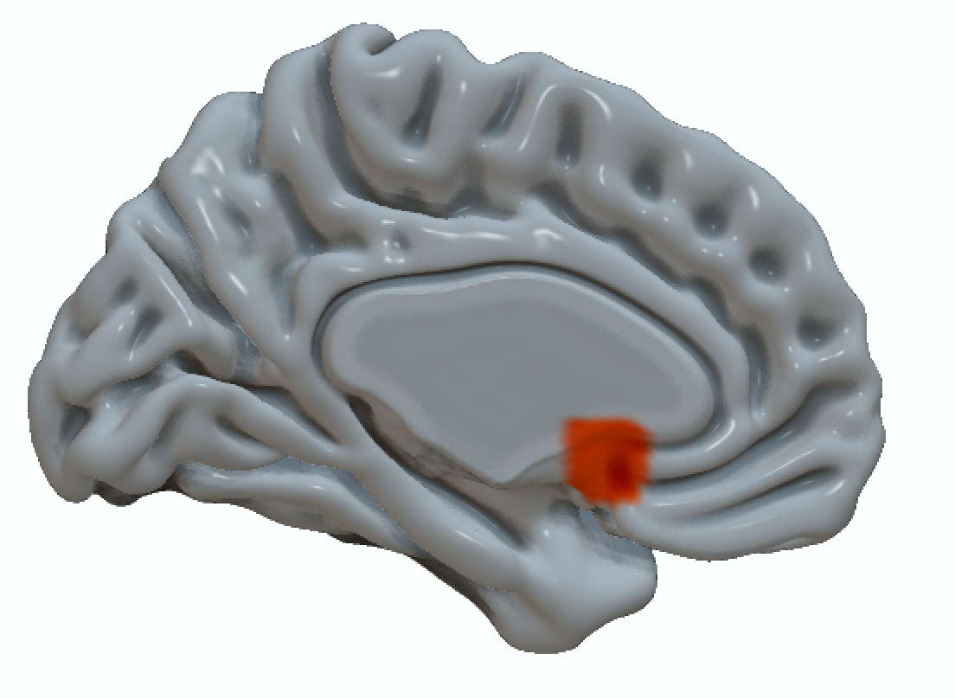
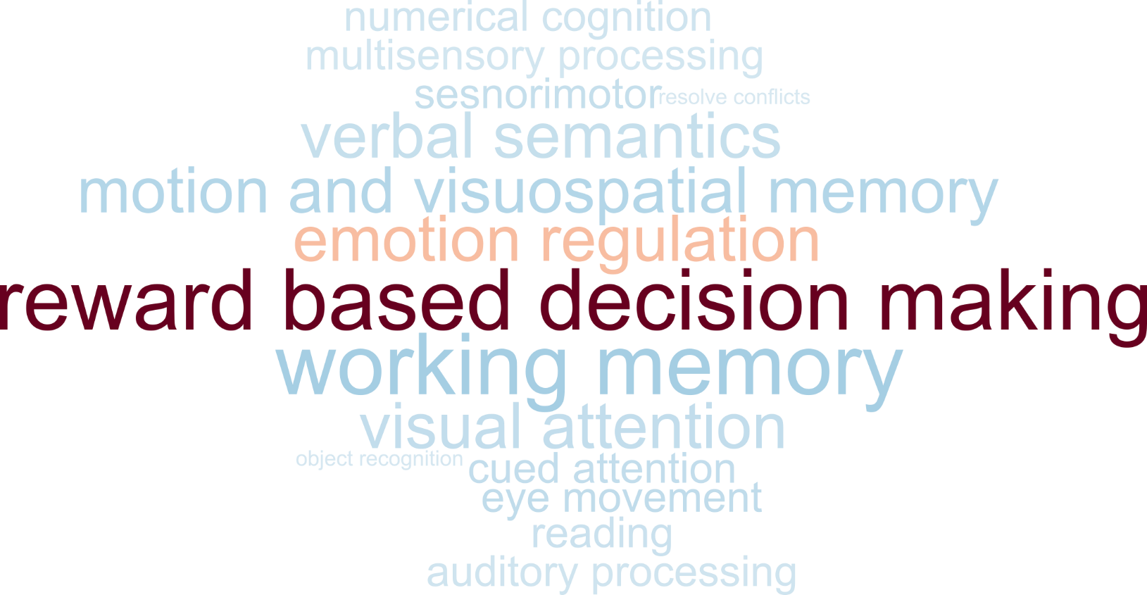
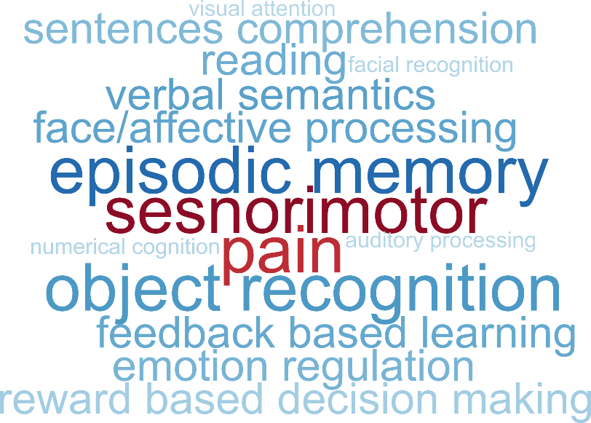
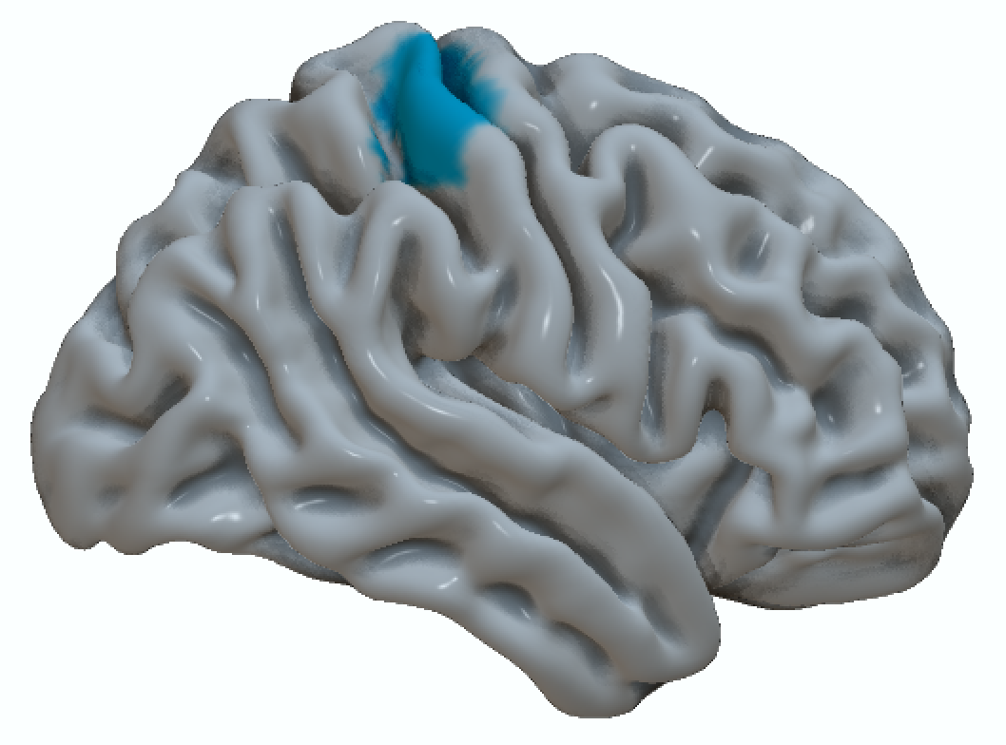
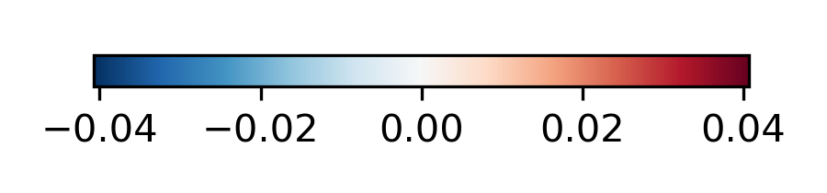
Region
Neurosynth decoding
Loading on Tasks
Cortical Thickness
Loading on FC
Cortical Thickness

Slide 6

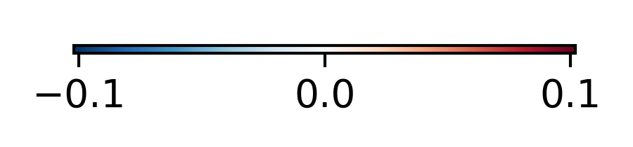
Association with experience
Functional connectivity (FC)
Task profile

